Slide 1
Retinal Detachment

Slide 2
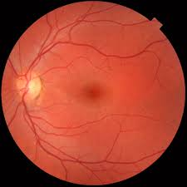
Anatomy of the retina

Slide 3
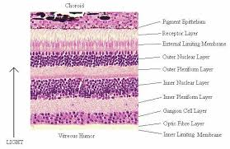

Slide 4
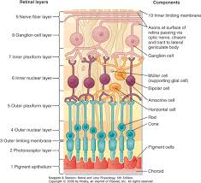

Slide 5
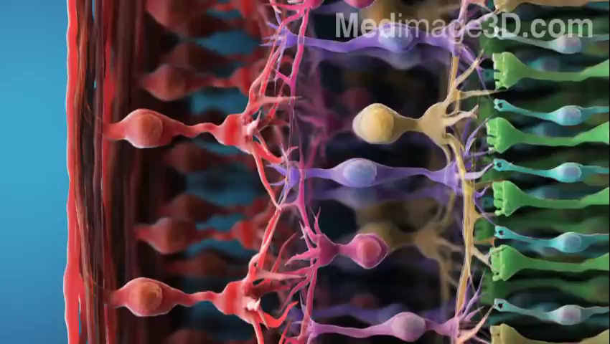

Slide 6
Retinal layers

Slide 7
Retinal Break
Classification
Pathogenesis
Tear
Hole
Morphology
U-shaped
L/J-shaped
Operculated
Dialysis
Giant
Location
Oral
Post-oral
Equatorial
Post-equatorial
Macular

Slide 8
RD
Definition.
Types:
- Rhegmatogenous.
- Tractional.
- Exudative.
- Combined.

Slide 9
Rhegmatogenous RD
Pathogenesis:
Vitreous synchisis.
PVD.
Vitroretinal traction.
Retinal tear.

Slide 10
eRD | tRD | rRD
Subretinal disease RPE damage Choroidal tumors PET | Vitro-retinal traction Diabetic Traumatic | Synchisis PVD Retinal tear | Pathogenesis
- +_Floaters VFD; sudden,rapidly progressive | - - VFD; slowly progressive | Photopsia Floaters VFD | Symptoms
Convex Deep Very mobile,shifting | Concave Shallow Immobile Not extent to ora | Convex Deep Mobile Corrugation to ora Opaque Dark Bl.Vs. | Signs

Slide 11
Surgical treatment
Find all retinal breaks.
Seal all retinal breaks.
Drain SRF.
Relieve VR traction:
Scleral buckle.
Vitrectomy.
Pneumatic retinopexy.

